Slide 1
PHP Programming with NetBeans

Slide 2
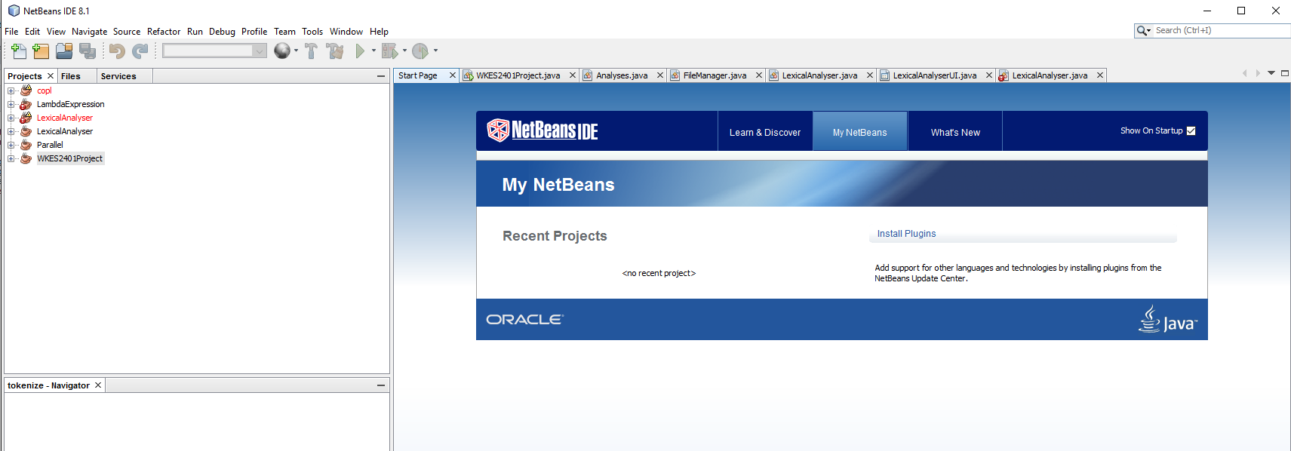
What you need to have

Slide 3
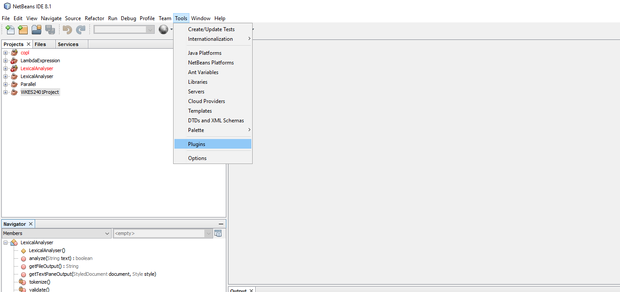
Install the PHP plugin

Slide 4
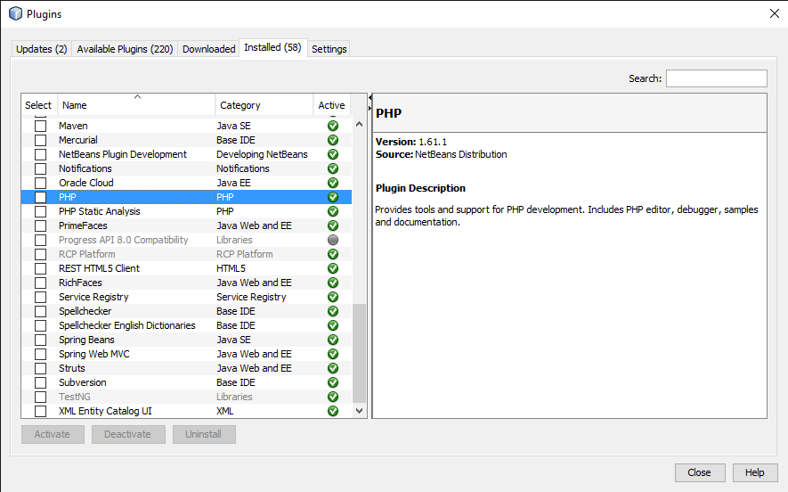
After installing the plugin

Slide 5
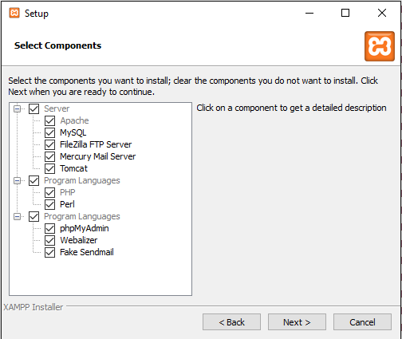
Download XAMPP and install

Slide 6
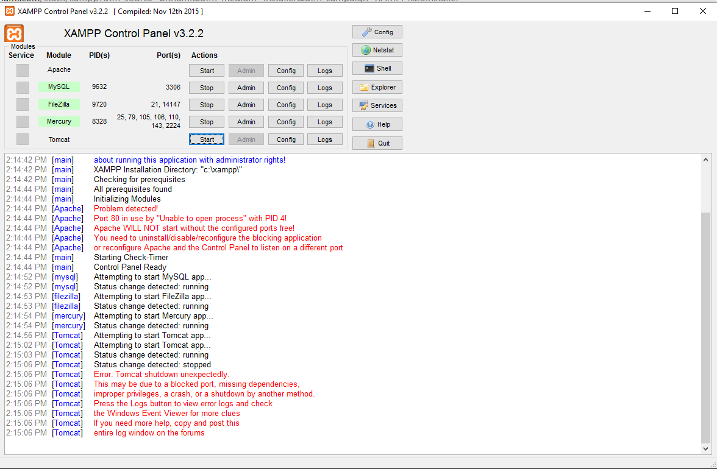
Run XAMPP
Apache must be started

Slide 7
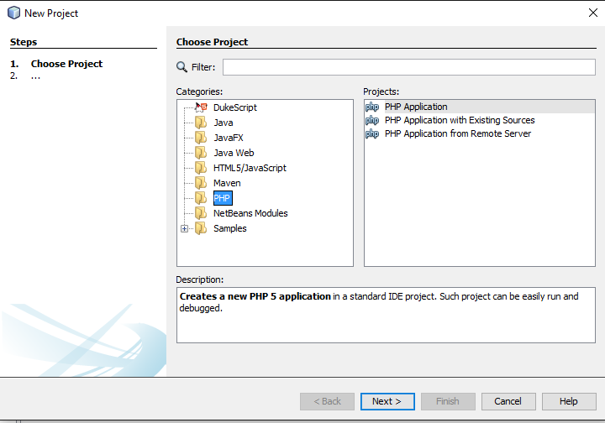
Create a PHP project
File ->New Project -> PHP

Slide 8
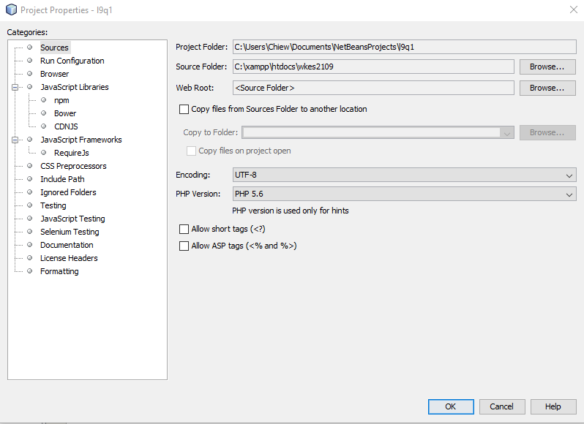
Point source folder to XAMPP

Slide 9
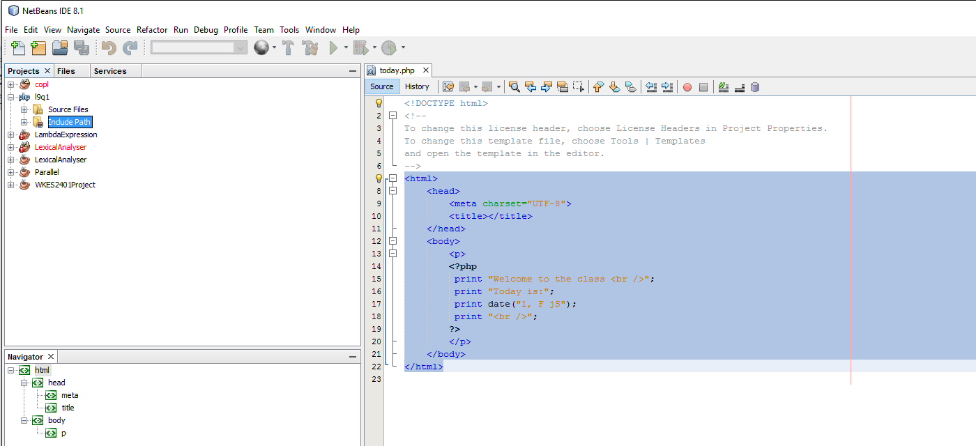
Write PHP document

Slide 10
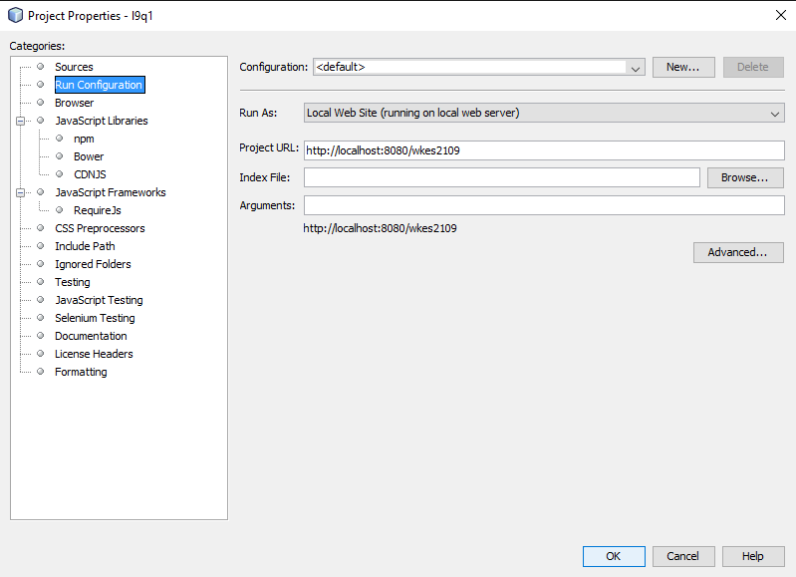
Run->Set Project Configuration

Slide 11
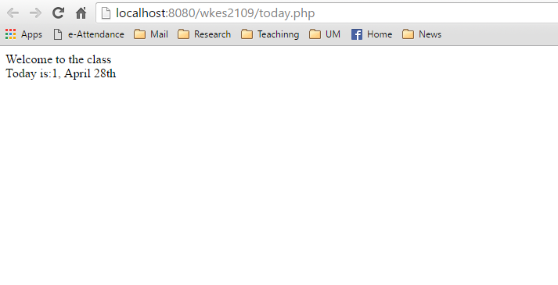
Run the file

